Slide 1
Data Query
Session 6

Slide 2
Objectives
Explain the simple T-SQL statements to query existing data
Explain the T-SQL statements to conditionally query existing data
Explain the T-SQL statement to query existing data by group
Explain the T-SQL statements to indistinctly query existing data
Describe and apply various aggregate functions of SQL Server
Describe and apply INNER JOIN to query multiple tables

Slide 3

What is a Query?
A request or a
question regarding
Query
Data in Tables
Initiates
Processed by
SQL Server
Answers the query – returns the result set
User

Slide 4
‘Select’ statement in a Query
Retrieves rows and columns
May include more than one table or more than one database.
Defines the columns required by the query as a series of expressions.
Resulting columns are in the same order as in the query.

Slide 5
Parts of a SELECT statement
Columns
required
SELECT empno, ename, sal, deptno
FROM emp, dept
Table names
WHERE deptno=30
Condition
Other clauses
Used to retrieve rows and columns

Slide 6
SELECT – Syntax and Examples
Syntax: SELECT * FROM <Table_name>
E.g.: Select * from STUDENT
SELECT <COLUMN1>, <COLUMN2>… From <Table Name>
E.g.: Select Name, Class, Mark from STUDENT

Slide 7
ORDER BY clause
The ORDER BY clause sorts query results by one or more columns
A sort can be ascending (ASC) or descending (DESC)
By default, the records are sorted in ASC order.

Slide 8
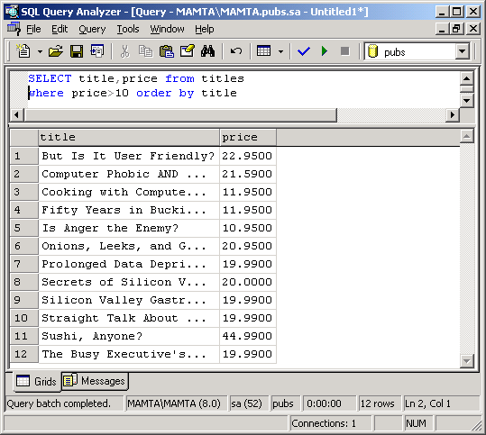
Displaying Sorted Data with SELECT and ORDER BY

Slide 9
DISTINCT clause
Eliminating duplicate rows using DISTINCT with SELECT
Syntax: SELECT DISTINCT <column1> FROM <tablename>
Example: SELECT DISTINCT deptno FROM emp

Slide 10
AS clause
The AS clause can be used either to change the name of a result set column or assign a name to a derived column.
For example, in order to display “PNR Number” as the heading for PNR_no column in the Reservation table, the SELECT statement is:
Select PNR_no as 'PNR NUMBER' FROM Reservation

Slide 11
SELECT with constraints
SELECT statements can also be used with constraints.
For example the IDENTITY constraint can be used
as follows:
Select IDENTITY (int,1,1) as p_id into
product_Det from products
Here Table1 is an existing table and Table2 is the table into
which we want to add the identity value.

Slide 12
TOP clause
The TOP clause limits the number of rows returned in
the result set.
The SELECT statement will be:
Syntax: SELECT TOP n <Column Name> FROM <table Name>
SELECT TOP 3 * FROM Meal

Slide 13
Aggregate functions-1
Generate summary values
Generate single value from each set of rows
Applied to all rows or to the rows of a WHERE clause
Examples, AVG, SUM, MAX, MIN, COUNT

Slide 14
Aggregate functions-2
SUM: returns the sum of all the values in an expression
AVG: returns the average of all the values in an expression
COUNT: returns the number of values in an expression
MAX: returns the maximum value in an expression
MIN: returns the minimum value in an expression

Slide 15

GROUP BY clause-1
Partitions the table into subsets where each subset has values in common
With aggregate functions, GROUP BY clause produces a single value per aggregate

Slide 16
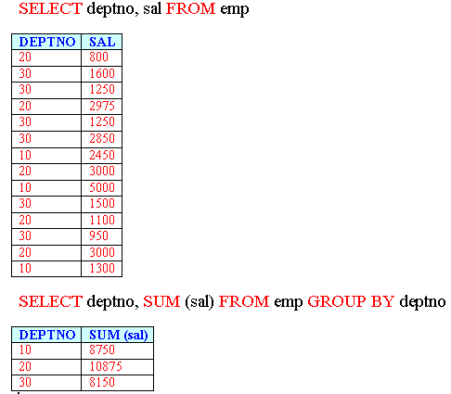
GROUP BY clause-2

Slide 17
GROUP BY clause(3)
WHERE clause is used along with ‘GROUP BY’ to restrict the rows for grouping
Null values are grouped together
ALL keyword – used with WHERE clause to include rows that do not satisfy search condition
Syntax: GROUP BY ALL <Column Name>

Slide 18
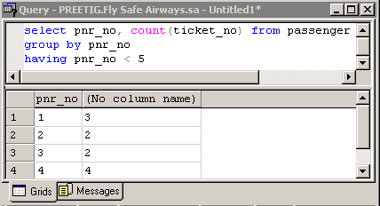
GROUP BY and HAVING clause
HAVING filters rows after grouping them
Operates on the Column with the aggregate function. (unlike ‘WHERE’ with GROUP BY)

Slide 19
Relational Operators and the WHERE clause
We can use different kinds of search conditions and comparison operators when constructing a WHERE clause.
The following table lists the different comparison operators that can be used in a query.
Operator
Meaning
=
Equal to
>
Greater than
<
Less than
>=
Greater than or equal to
<=
Less than or Equal to
<>
Not equal to
!
Not

Slide 20
Wildcard characters and LIKE
Wildcard
Description
Example
‘_’
A single character
Select Branch_Code From Branch Where Branch_Code Like ‘L__’
%
A string of any length
Select Route_Code From FlightSchedule Where Route_Code Like ‘AMS-%’
[]
A single character within the range enclosed in the brackets
Select Airbusno From FlightSchedule Where Airbusno Like ‘AB0[1-5]’
[^]
Any single character not within the range enclosed in the brackets
Select Airbusno From FlightSchedule Where Airbusno Like ‘AB0[^1-5]’

Slide 21
IN, BETWEEN and %
SELECT * FROM titles WHERE type IN (‘CLASSIC’, ‘ASTRO’)
SELECT * FROM authors WHERE zip BETWEEN 94025 AND 94050
SELECT * FROM authors WHERE member_name LIKE ‘P%’

Slide 22
Using Wildcard characters with LIKE
The LIKE operator is used to match strings or parts of a string (called substrings).
… WHERE <column1> LIKE (<value list>)
• Underscore (_) is used in a WHERE clause along with the LIKE operator to match any single character. For example ‘_at’ will match ‘rat’ or ‘bat’ but it will not match ‘rate’.
Suppose you want to check how many 24” soft, dark coloured suitcases are pending. For doing so, the records should be matched on the last character. The query will be
SELECT * FROM Pending WHERE Icode LIKE ‘STCS-24-S-D_’

Slide 23
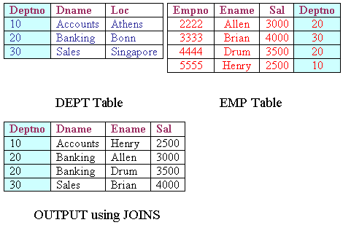
JOINS (1)

Slide 24
JOINS (2)
There are three types of Joins :
- Inner Joins
- Outer Joins
- Self Joins

Slide 25
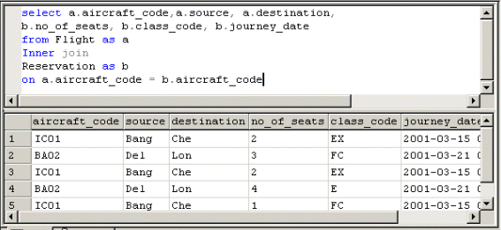
Inner Joins
Records from two tables are combined and
added to a query’s result, only if the rows
from both the tables match based on a
common column

